Slide 1


The PPARγ Antagonism Inhibits HIV Replication but Sustains RORγt-Mediated Effector Functions in Th17 Cells
Petronela Ancuta, Ph.D.
Professor of Immunology
Université de Montréal, Faculté de Medecine,
Département de microbiologie, infectiologie et immunologie
Centre de recherche du CHUM

Slide 2
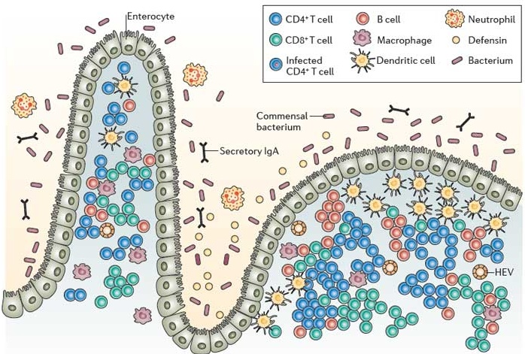
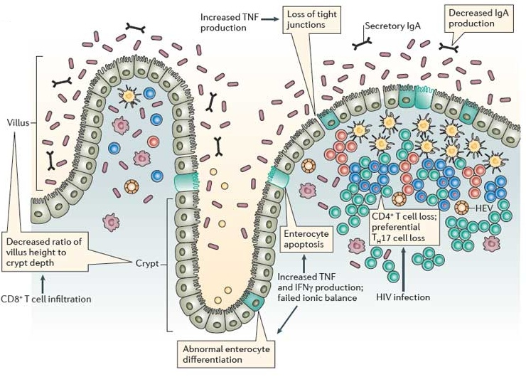
Th17 Cells in Mucosal Immunity Homeostasis and HIV Pathogenesis
Uninfected
HIV-infected
● Th17-specific cytokines act on :
→ B cells to increase the production of IgA
→ epithelial cells to increase the production of
- antibacterial beta-defensins
- CCL20, a chemoattractant for DC, B cells, Th17 cells and other cell types
- IL-8, a chemoattractant for neutrophils, a source of anti-viral alpha-defensins
Sandler and Douek, Nat. Rev. Microbiol., 2012

Slide 3
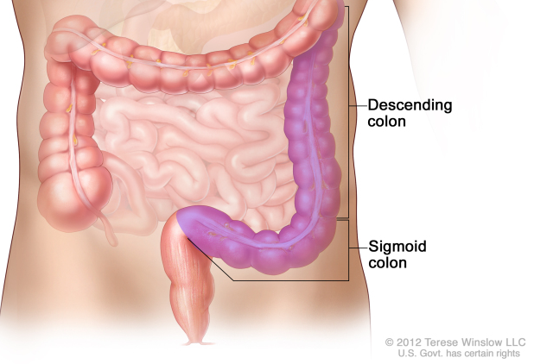

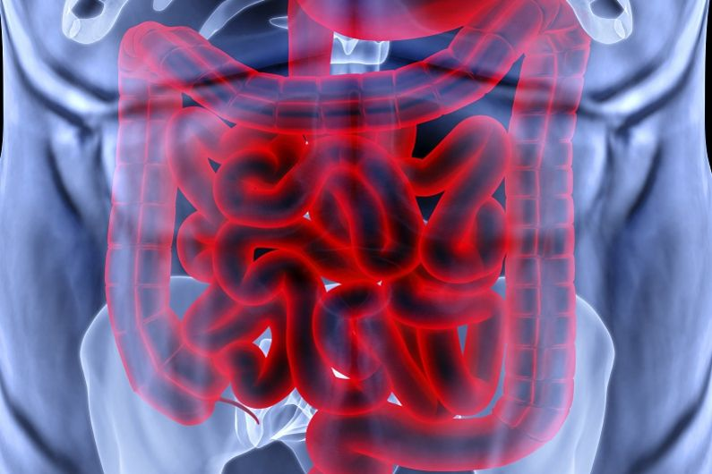
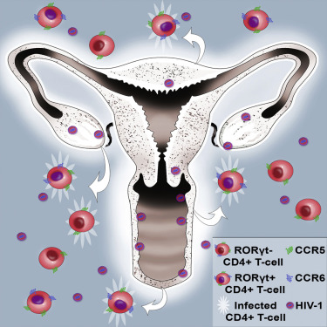

Th17 Cells are Major Targets for HIV Infection and Viral Reservoir Persistence during ART
Th17-polarized CD4+ T-cells
Acosta-Rodriguez et al., Nat Imm, 2007
Annunziato et al., JEM, 2007
Wan et al., JEM, 2011
Enriched
in HIV reservoirs during ART
Gut homing tropism
CCR6
CD4/CCR5
Integrin α4β7
Gosselin/Wiche Salinas et al., AIDS, 2017
Wang et al., Mucosal Immunology, 2009
Lugering et al., Am J. Pathol, 2005
Salazar-Gonzalez et al., Immunity, 2006
Gosselin et al., JI, 2010
Monteiro et al., JI, 2011
El-Hed et al., JID, 2010
Alvarez et al., JVI, 201X
Increased HIV permissiveness
First targets of infection during SIV vaginal challenge
Daniel J. Stieh, Cell Host and Microbe, 2016

Slide 4
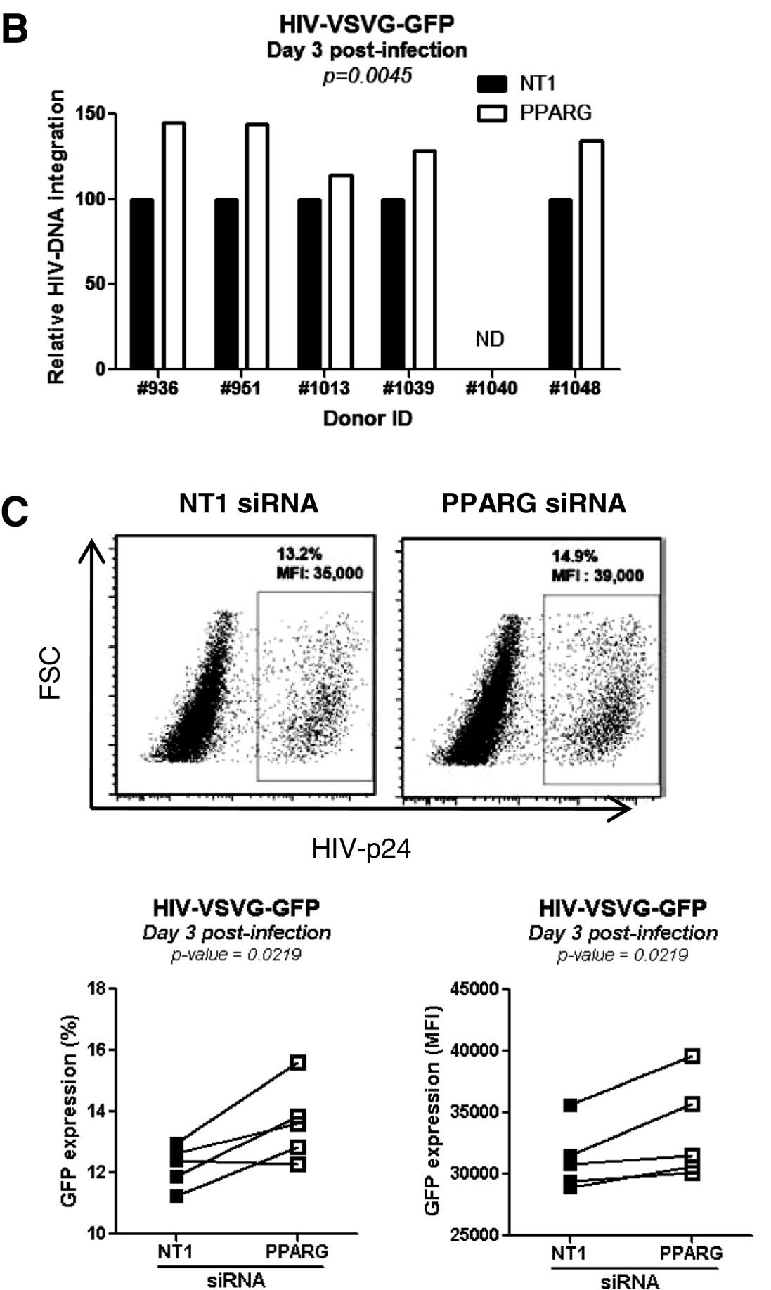
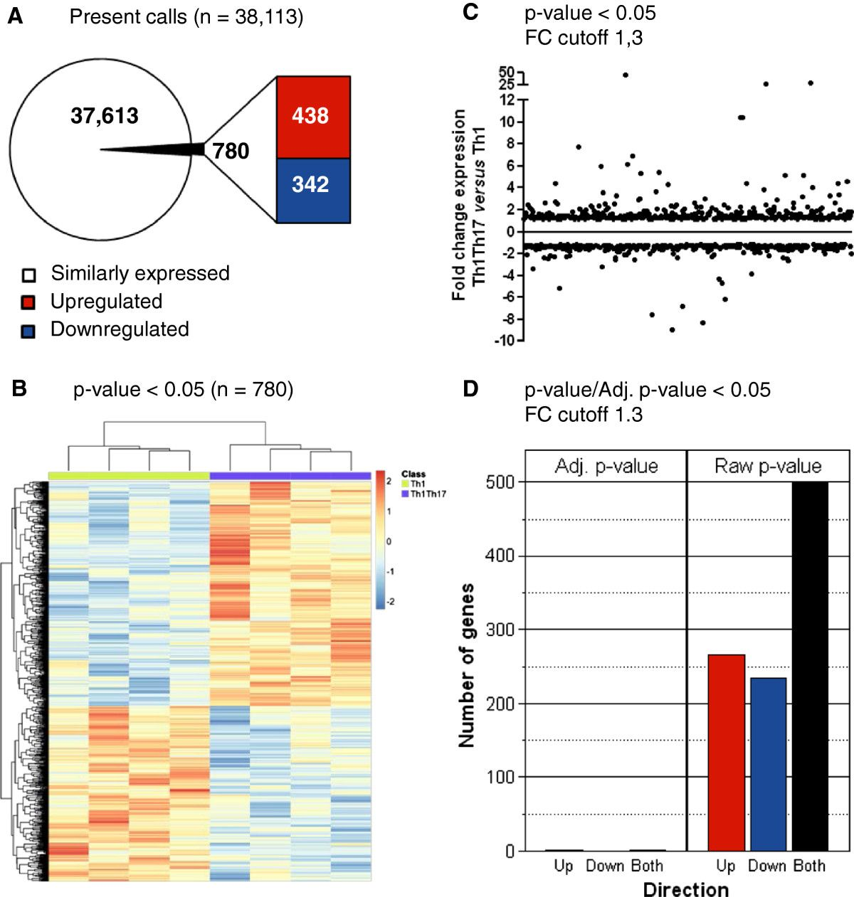
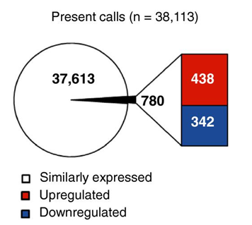
PPARγ Is an Intrinsic Negative Regulator of HIV Replication in Pathogenic Th17 Cells
Th1 vs. Th1Th17
Bernier et al., Retrovirology, 2013

Slide 5
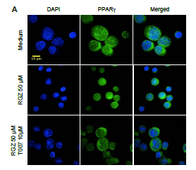
The Nuclear Translocation of PPARγ Is Induced by Agonism and Prevented by Antagonism
Hypothesis:
PPARγ antagonism may be used in HIV reservoir reactivation strategies
Bernier et al., Retrovirology, 2013

Slide 6
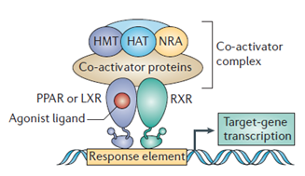
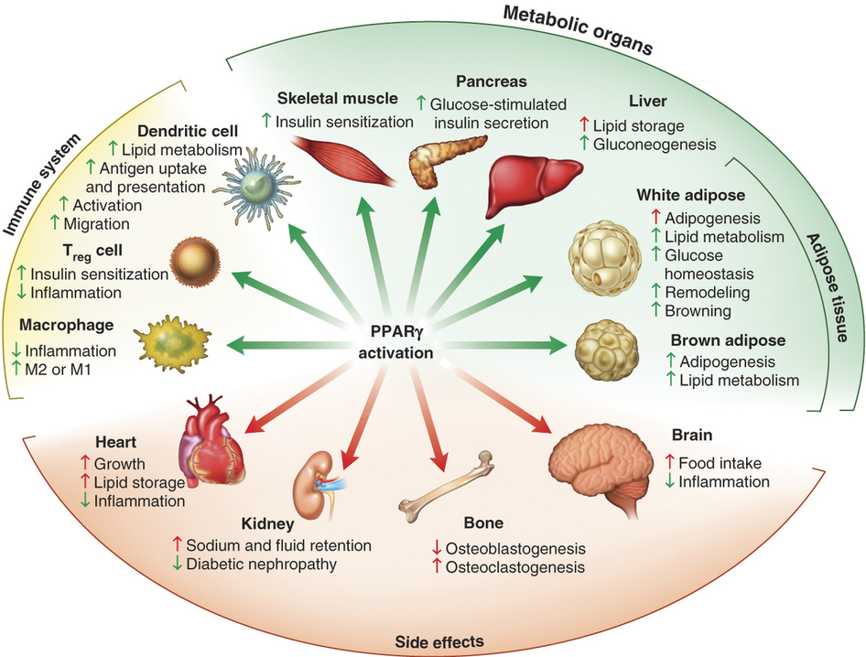
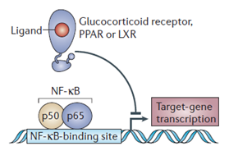
Peroxysome Proliferator Activated Receptor Gamma (PPARγ)
NF-kB
AP1
STAT
NFAT
RORC → Master regulator
gene of Th17
Nature Reviews Immunology 6, 44-55

Slide 7
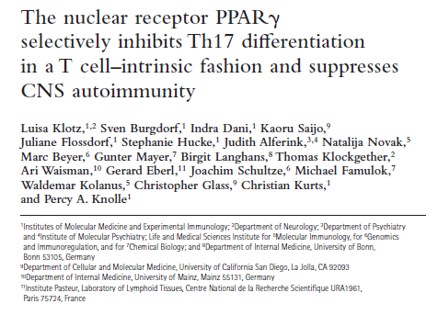
PPARγ: A RORγt Transcriptional Repressor
Klotz et al., The Journal of Experimental Medicine, 2009

Slide 8
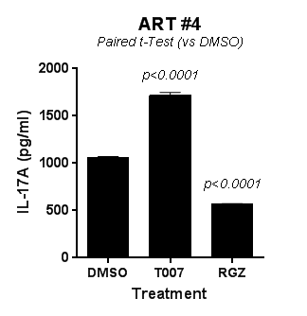
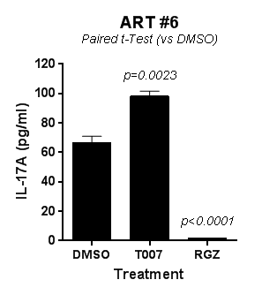
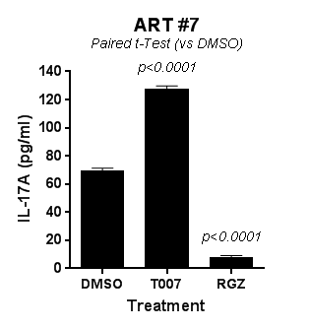
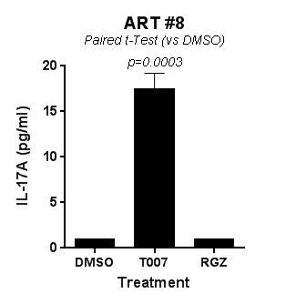
The PPARγ Antagonism But Not Agonism
Boosts IL-17A Production in Memory CD4+ T-Cells of
ART-Treated Individuals ex vivo
T0070907 (T007), PPARG antagonist
Rosiglitazone (RGZ), PPARg agonist
Zhang/Planas et al., manuscript in preparation, 2018

Slide 9
PPARγ Antagonism Boosts HIV Transcription Upon Viral Reservoir Reactivation ex vivo
Short-term HIV reactivation procedure in the presence of ARVs in vitro
DMSO
Memory CD4+ T-cells
(HIV+ on ART)
T007
18 hours
Day -3
Day 0
CD3/CD28 Abs
IL-2 ± T0070907
ARVs (Raltegravir / Saquinavir)
Cell-Associated HIV-RNA
T007, PPARG antagonist
Zhang/Planas et al., manuscript in preparation, 2018

Slide 10
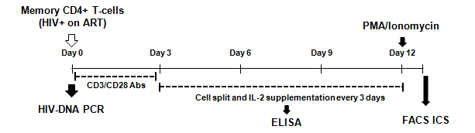
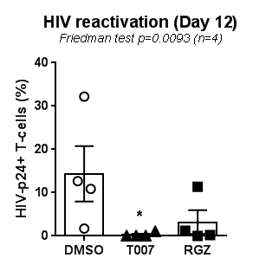
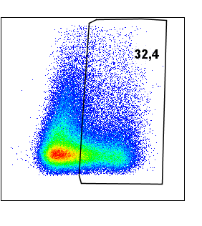
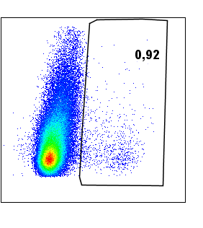
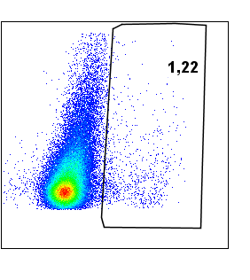
Both PPARγ Antagonism and Agonism
Inhibit HIV Reactivation in Memory CD4+ T-Cells of ART-Treated Individuals ex vivo
Medium
T007
RGZ
FSC
HIV-p24
T007, PPARG antagonist
RGZ, PPARg agonist
Zhang/Planas et al., manuscript in preparation, 2018

Slide 11
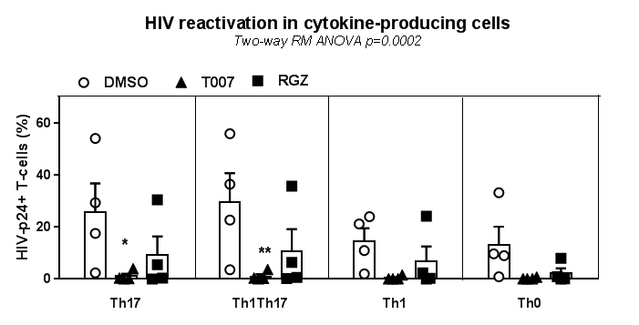
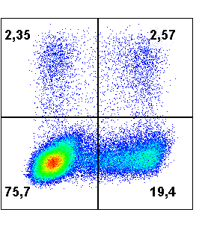
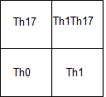
Both PPARγ Antagonism and Agonism Inhibit
HIV Reactivation in Th17 and Th1Th17 Cells ex vivo
IL-17A
IFN-γ
T007, PPARG antagonist
RGZ, PPARg agonist

Slide 12
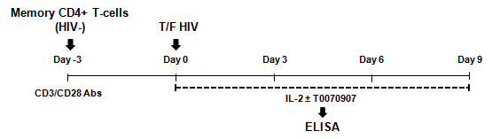
PPARγ Antagonism Increases IL-17A Production but Inhibits HIV Replication in vitro
T007, PPARG antagonist
Each symbol represents a different donor
Zhang/Planas et al., manuscript in preparation, 2018

Slide 13
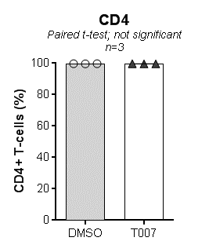
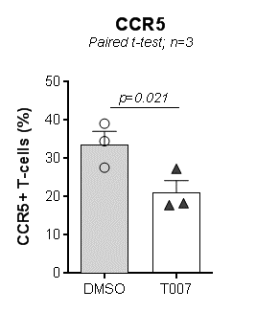
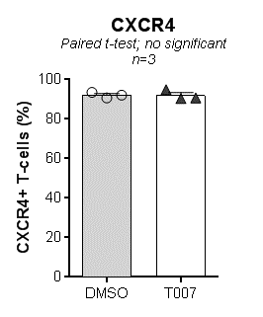
PPARγ Antagonism Decreases CCR5 Expression on Memory CD4+ T-Cells Upon TCR Triggering in vitro
T007, PPARG antagonist
Each symbol represents a different donor
Zhang/Planas et al., manuscript in preparation, 2018

Slide 14
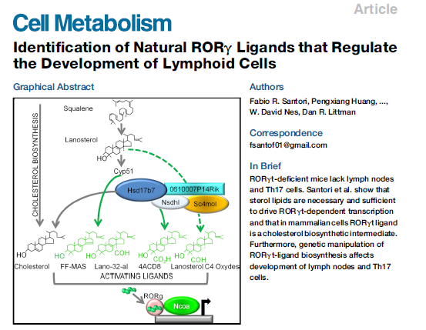
Cholesterol Derivatives are RORγt Ligands
Santori et al., Cell Matabolism, 2015

Slide 15
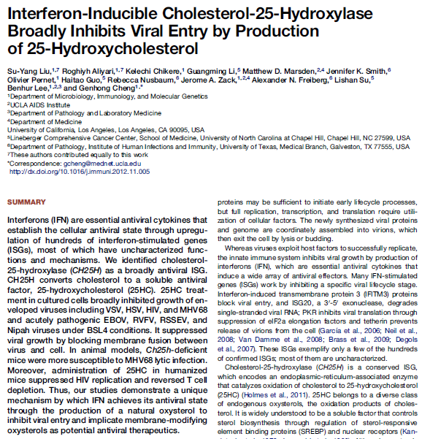
The Cholesterol-25-Hydrolase (CH25H) Promotes
HIV Restriction via 25-Hydroxycholesterol (25HC)
Liu et al., Immunity, 2013

Slide 16
The PPARγ Antagonism Increases
Cholesterol 25-Hydrolase mRNA Expression
DMSO
T007
T007, PPARG antagonist
Each symbol represents a different donor
Zhang/Planas et al., manuscript in preparation, 2018

Slide 17
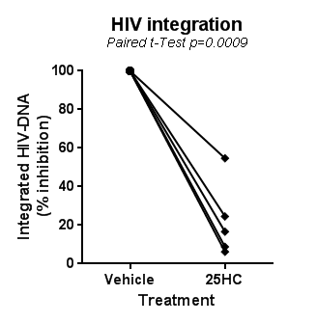
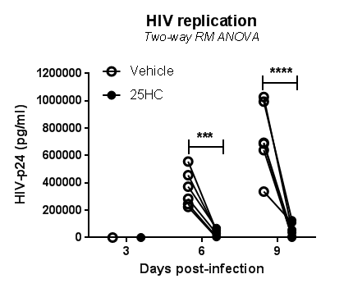
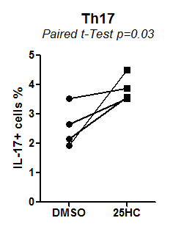
Exogenous 25HC Inhibits HIV Integration and Replication while Promoting Th17 Effector Functions
Zhang/Planas et al., manuscript in preparation, 2018

Slide 18
PPARγ Antagonism Promotes IL-17A Production and Inhibits HIV Replication in Specifically in CCR6+ T-Cells in vitro
FACS sorting of memory CCR6- and CCR6+ T-cells
T007, PPARG antagonist
Each symbol represents a different donor
Zhang/Planas et al., manuscript in preparation, 2018

Slide 19
PPARγ Antagonism Decreases CCR5 Expression on Memory CCR6+ T-Cells
FACS sorting of memory CCR6- and CCR6+ T-cells
T007, PPARG antagonist
Each symbol represents a different donor
Zhang/Planas et al., manuscript in preparation, 2018

Slide 20
PPARγ Antagonism Promotes CH25H mRNA Expression in
Memory CCR6- BUT NOT CCR6+ T-Cells
FACS sorting of memory CCR6- and CCR6+ T-cells
T007, PPARG antagonist
Each symbol represents a different donor
Zhang/Planas et al., manuscript in preparation, 2018

Slide 21
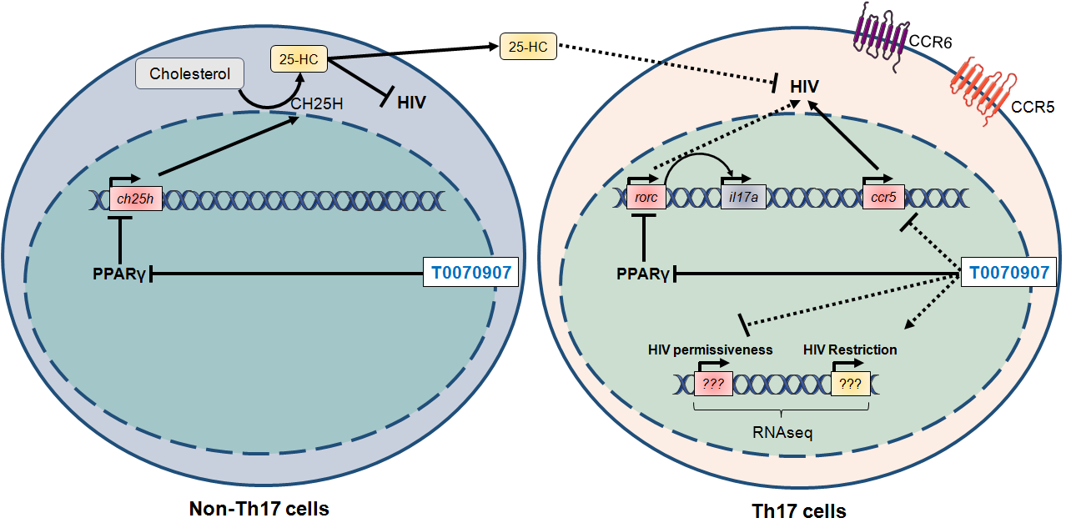
The PPARG Antagonism Mediates HIV Restriction in CCR6+ T-Cells via CH25H-Independent Mechanism
Zhang/Planas et al., manuscript in preparation, 2018

Slide 22
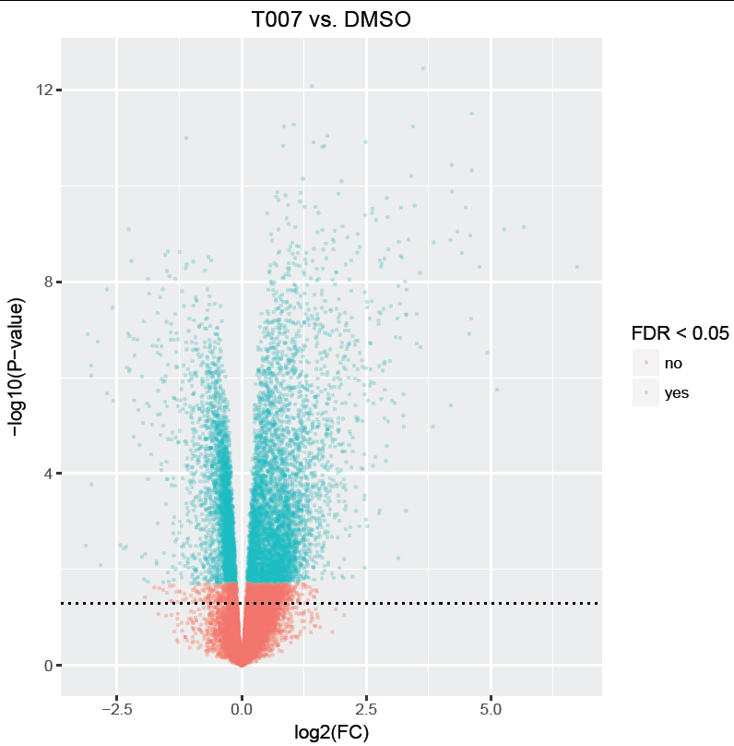
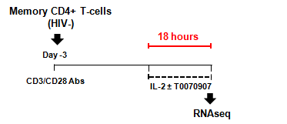
RNA-Seq Reveals Profound Transcriptional Modifications Induced by PPARγ Antagonism in CCR6+ T-Cells
FACS sorting of memory CCR6+ T-cells
Zhang/Planas et al., manuscript in preparation, 2018

Slide 23
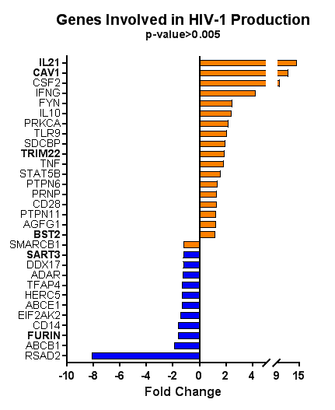
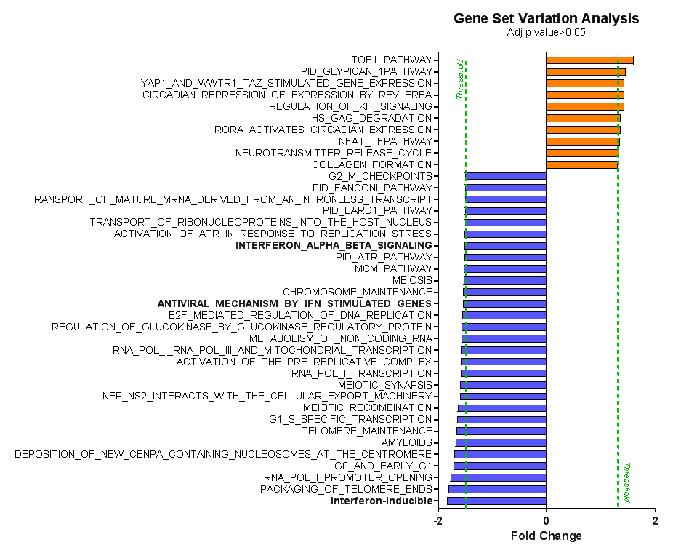
PPARγ Antagonism Induces Profound Transcriptional Modifications in CCR6+ T-Cells
Zhang/Planas et al., manuscript in preparation, 2018

Slide 24
The Take Home Message
The PPARγ antagonism boosts Th17 effector functions
The PPARγ antagonism increases HIV transcription but blocks HIV cell-to-cell transmission by acting at multiple levels of the HIV replication cycle (i.e., entry and budding)
The potential use of PPARγ antagonism as a therapeutic strategy for HIV remission and/or cure requires further investigations

Slide 25
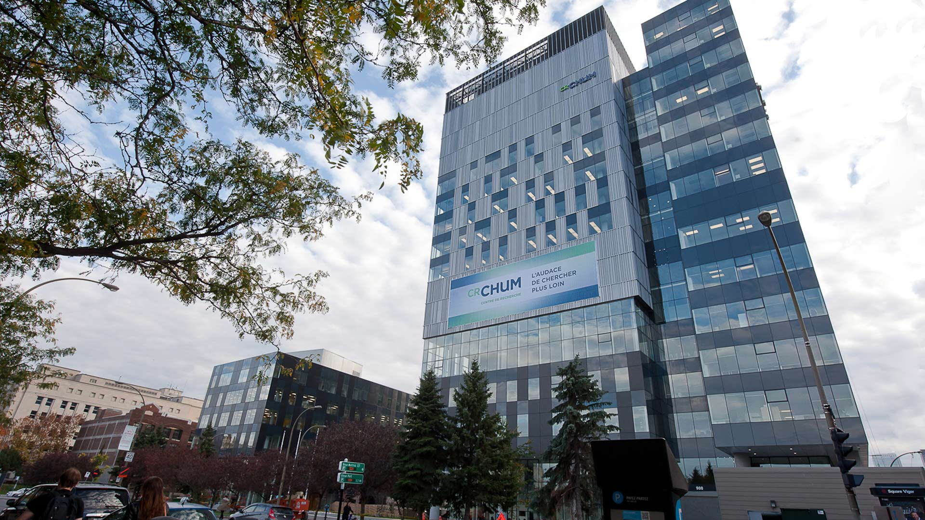


The CHUM Research Centre in Montréal
Yuwei Zhang
Postdoctoral Fellow
Delphine Planas
Ph.D. Student

Slide 26






Acknowledgements
Ancuta’s Lab. CRCHUM
Yuwei Zhang, PDF
Delphine Planas, Ph.D. Student
Tomas Wiche Salinas, Ph.D. student
Laurence Raymond Marchand, M.Sc.
Annie Gosselin, M.Sc
Vanessa Sue Wacleche, Ph.D.
Chomont’s Lab. CRCHUM
Nicolas Chomont, Ph.D.
Maria Julia Ruiz, PDF
Plateforme de Cytométrie CRCHUM
Dominique Gauchat, Ph.D.
Cohorte de primo infection/Biopsies
Université McGill
Jean-Pierre Routy, M.D.
Josée Girouard et Angie Massicotte
Réseau FRQ-S MI/SIDA
Mario Legault
A special thank to all HIV-infected and uninfected study participants
for their generous and precious gift of biological samples

Slide 27
Current Goals in HIV Research
  → HIV remission
  Improve ART to control residual viral replication and prevent viral reservoir replenishment
  Improve antiviral immunity and restore the immunological barrier function, especially at mucosal level
  Induction of HIV latency via “block and lock” strategies
  → HIV cure
  Identify long-lived cellular HIV reservoirs persisting during ART and purge them via “shock and kill” strategies

Slide 28
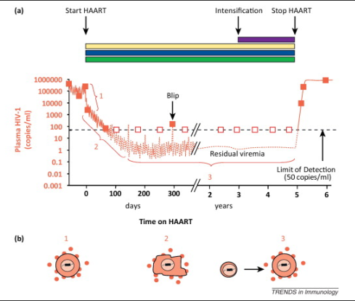
The Limits of Antiretroviral Therapy
  ARVs do not act at the level of HIV transcription → residual viral replication
  ARVs do not interfere with the persistence of viral reservoirs in long-lived cells → viral reservoir persistence
  ARVs may poorly penetrate in specific tissues and/or cell subsets → viral reservoir replenishment
  ART, antiretroviral therapy
  ARVs, antiretroviral drugs
Durand et al. Trends. Immunol 2012

Slide 29
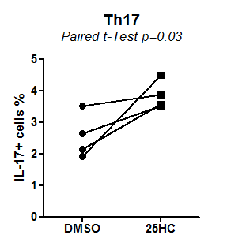
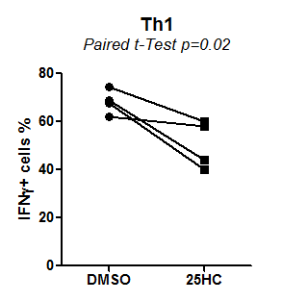
25-Hydroxy Cholesterol Promotes
Th17 Effector Functions
Zhang/Planas et al., manuscript in preparation, 2018

Slide 30
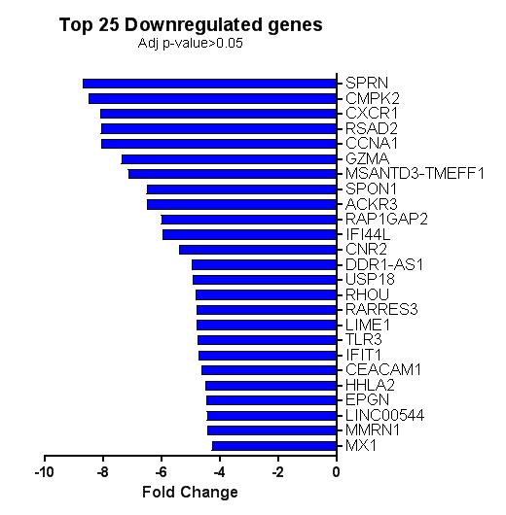
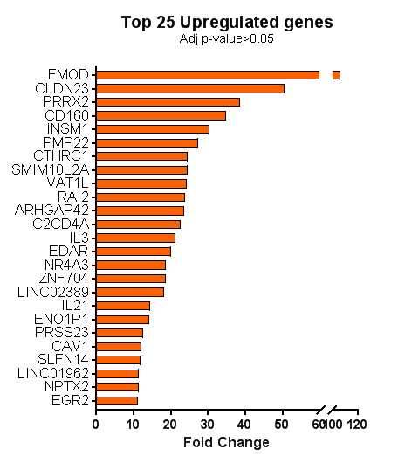
PPARγ Antagonism Induces Profound Transcriptional Modifications in CCR6+ T-Cells
Zhang/Planas et al., manuscript in preparation, 2018

Slide 31
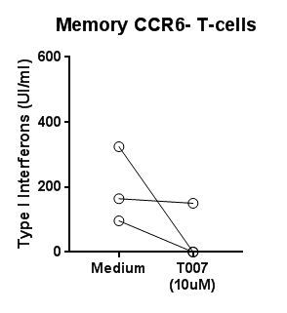
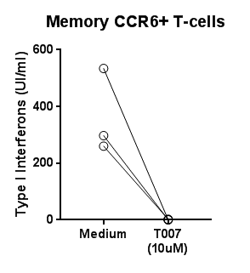
PPARγ Antagonism Increases IL-17A Production and Inhibits HIV Replication in vitro
D
E
Zhang/Planas et al., manuscript in preparation, 2018

Slide 32
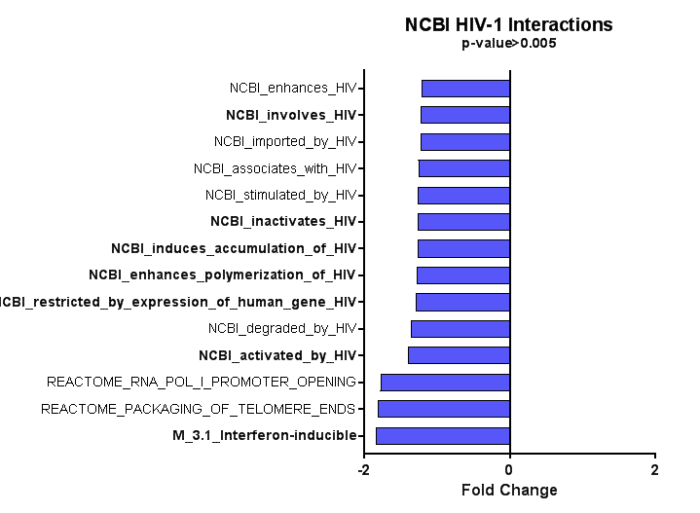
PPARγ Antagonism Increases IL-17A Production and Inhibits HIV Replication in vitro
A
B
Zhang/Planas et al., manuscript in preparation, 2018

Slide 33
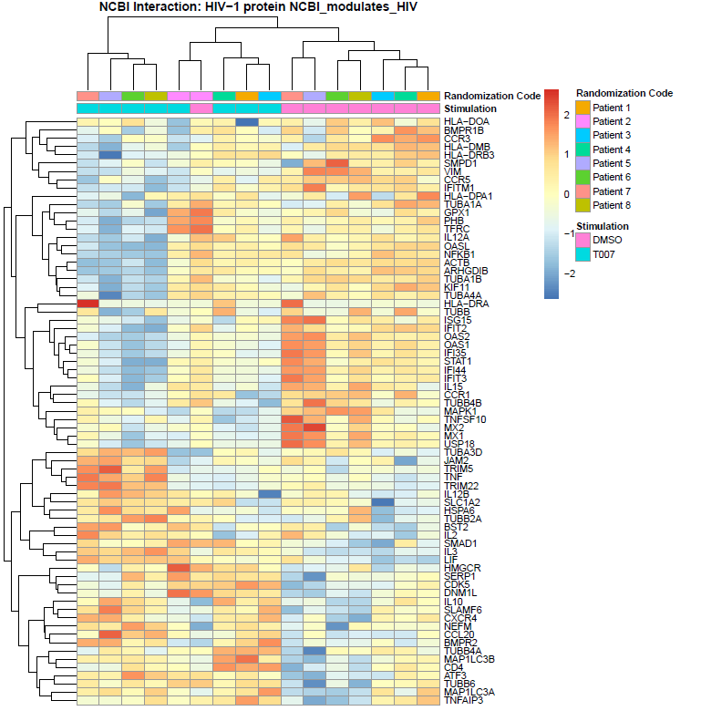
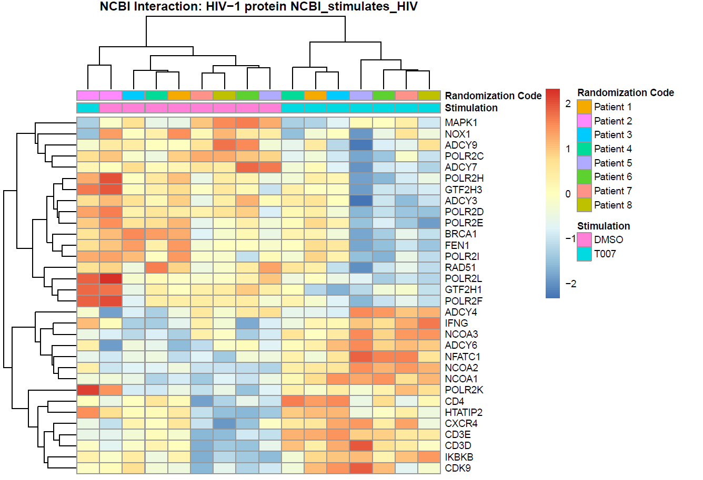
PPARγ Antagonism Increases IL-17A Production and Inhibits HIV Replication in vitro
C
D
Zhang/Planas et al., manuscript in preparation, 2018

